Slide 1
SYS-LIFE COFUND Kick-Off Meeting
Faculty of Medicine
11.11.2024
SYS-LIFE Second Call – Online Launch

Slide 2
Summary
Introduction What is MSCA COFUND?
Introducing ’SYS-LIFE’
Who can apply?
What work will you do?
Why is SYS-LIFE good for me?

Slide 3
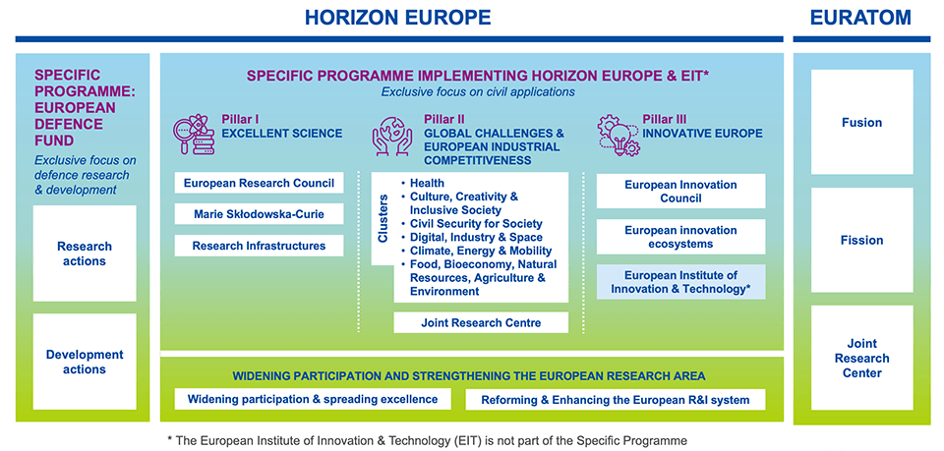
What is MSCA COFUND?
Part of Horizon Europe 95,5bn € Programme
Notes:
Marie Skłodowska-Curie Actions (MSCA) are the European Union's reference programme
for doctoral education and postdoctoral training. COFUND supports:
Doctoral Programmes: Research training activities to allow doctoral candidates to develop and broaden their skills and competences.
Postdoctoral Programmes: Individual advanced research training and career development fellowships for postdoctoral researchers.
Co-fund regional, national and international programmes for training and career development
Spread MSCA best practices, promoting high standards and excellent working conditions
Promotes sustainable training and international, interdisciplinary and inter-sectoral mobility

Slide 4
What is MSCA COFUND?
Part of Horizon Europe 95,5bn € , 7-year programme
Marie S. Curie Actions: COFUND
Annual Budget: 95 M €
Programmes: PhD or Postdoctoral
Maximum duration of programme: 5 years
Minimum duration of fellowships: 3 months
Minimum researchers recruited: 3
Maximum EU Contribution: 10M €
Notes:
Marie Skłodowska-Curie Actions (MSCA) are the European Union's reference programme
for doctoral education and postdoctoral training. COFUND supports:
Doctoral Programmes: Research training activities to allow doctoral candidates to develop and broaden their skills and competences.
Postdoctoral Programmes: Individual advanced research training and career development fellowships for postdoctoral researchers.
Co-fund regional, national and international programmes for training and career development
Spread MSCA best practices, promoting high standards and excellent working conditions
Promotes sustainable training and international, interdisciplinary and inter-sectoral mobility

Slide 5
What is MSCA COFUND?
Purpose: Excellent Research and Training Programmes at PhD and Postdoctoral Level, accredited by MSCA
Focus: International, Interdisciplinary, Intersectoral Excellence
EU Contributes: majority of salary costs
Beneficiary Contributes: the rest!
i.e. remaining salary costs, allowances, management, administration
Beneficiaries and their partners can be:
Universities | Government Entities
Research Organisations | Regional Authorities
Businesses | Funding agencies
Notes:
This is the minimum salary that researchers should receive.

Slide 6
MSCA COFUND – some useful info:
Researchers hired by any COFUND programme:
Can be of any nationality
MSCA mobility rule: Must not have resided or carried out their main activity (work, studies, etc.) in employer’s country for more than 12 of the 36 months before call deadline
Researchers hired by a COFUND Postdoctoral Programme:
must have a doctoral degree by Call deadline
should not already be permanently employed by the employing organization
Can go on short-term secondments (up to 1/3 of total duration of role)
Salary paid by programme as normal during secondment
Purpose must be for research and training (cannot work for secondment host)
Secondment hosts can include researcher’s previous organisation(s) but researchers must not have spent more than 12 months in the secondment host’s country within the 36 months before call deadline (i.e. 3 Jan 2022 - Jan 2025)

Slide 7
UTU and COFUND – a success story
Since 2022, UTU has captured ca. 11M € with 4 successful projects
1. Turku Intersectoral Excellence Scheme (TIES: Postdoc 2022):
8 Postdoc positions, based at TIAS Collegium
Research must address problems affecting society outside academia (private, public and not-for profit)
Must complete a 1-6 month secondment outside academia
2. Systemic approaches to improve cardiometabolic & brain health during lifespan (SYS-LIFE: Postdoc 2023)
22 Postdoc positions, based in faculties of Medicine, Technology, Natural Science
Research must aim to improve cardiometabolic and/or brain health
Research must engage with the core research expertise of the University of Turku
3. Solutions for Green and Digital Transition (GreDiT: PhD 2023)
25 PhD positions, based in UTUGS (faculties of Technology, Natural Science & Turku School of Economics)
Training ecosystem to develop as experts able to bring about transformative change
Must complete a 4-6 month secondment at a programme partner (non-academic)
4. Human-Centric Artificial Intelligence for Sustainable Future (HAIF: PhD 2024)
25 Postdoc positions, based in UTUGS (faculties of Technology, Social Sciences, Law and Humanities)
Research situated within thematic areas of: Sustainable AI, Human-Centric AI, Safe & Secure AI, Robust & Scaleable AI
Must complete a 4-6 month secondment at a programme partner (academic or non-academic)

Slide 8
Introducing ‘SYS-LIFE’
Systemic approaches to improve cardiometabolic and brain health during lifespan
WHY?
Cardiometabolic diseases and brain disorders account for over 48 % of mortality in the EU, costing millions of lost working years and more than €1.6 trillion in expenses every year
UTU has world class resources for research in these fields, inc. unique data sets and broad infrastructure
Typically, postdocs in the EU do not have a steady job, research autonomy or career development support
Crossing boundaries to achieve breakthroughs can thus be risky
Notes:
Progress made since 2018 in supporting PhD Development
“So far, there is still a lack of knowledge about postdoctoral researchers”
Postdocs often do not have a steady position in academia:
57% of respondents – postdoc phase lasts 1-4 years
43% say it lasts 5-12 years
Despite career insecurity, postdocs spend most of their time on research, applications and teaching. Career development remains a low priority.
Source: European Universities Alliance: Council for Doctoral Education, Survey 2022
SYS-LIFE postdocs expected to engage new partners AND connect University research expertise and infrastructure
Faculty of Medicine seeks to roll out SYS-LIFE’s innovative training and mentoring options to ALL its postdocs:
This is the first time that this has been done in Finland
Many SYS-LIFE postdocs will be from outside Finland: opportunity to increase international contacts + competitiveness

Slide 9
Introducing ‘SYS-LIFE’
Systemic approaches to improve cardiometabolic and brain health during lifespan
SYS-LIFE ENCOURAGES APPROACHES THAT ARE:
Interdisciplinary (draw from methods across STEM and beyond)
Intersectoral (engage knowledge and resources outside academia)
Systemic (whole-body vision, connecting organs, diseases or systems)
Longitudinal (relate to multiple points in the human life-cycle)

Slide 10
Introducing ‘SYS-LIFE’
Systemic approaches to improve cardiometabolic and brain health during lifespan
WHAT?
22 full-time research positions
36 month role, inc. secondment option - up to 12 months in/outside academia
Collegium, Bottom-Up Excellence Model. SYS-LIFE researchers:
Design and lead innovative projects to improve cardiometabolic and brain health
Meets regularly as a group to share learning and perspectives
Career Planning: Skills gaps identified and addressed by group or individual training
Secondments and other support available by mutual agreement from partners, inc. Turku University Hospital, University of Ghent, Siemens Healthineers, and Turku Science Park.

Slide 11
Introducing ‘SYS-LIFE’
Systemic approaches to improve cardiometabolic and brain health during lifespan
WHO CAN APPLY?
Must possess a doctoral degree, awarded no longer than 8 years prior to the call deadline
Can be of any nationality
Must NOT have resided or carried out their main activity (work, studies, etc.) in Finland for more than 12 of the 36 months before the Call deadline (Marie S. Curie Mobility Rule)
Returning residents of Finland are eligible
Must possess at least one Letter of Support from a host unit at UTU
Notes:
Letter of Support addition also proposed, requiring prospective host departments to confirm that the proposed research can be hosted in principle.
need to avoid pre-selection. provide same opportunities.

Slide 12
Introducing ‘SYS-LIFE’
Systemic approaches to improve cardiometabolic and brain health during lifespan
APPLICATION REQUIREMENTS
Completed application package submitted, in English, by the call deadline
Research must aim to improve cardiometabolic and/or brain health
Research must engage with the University’s core research expertise.
Must comply with UTU policies (including those on research ethics) and with local law

Slide 13
Introducing ‘SYS-LIFE’
Systemic approaches to improve cardiometabolic and brain health during lifespan
REQUIREMENTS DURING THE PROGRAMME
Full-time dedication (1,612 hours per year)
Participation at all events as required
Create and maintain a Personal Career Development Plan with Mentor
Create and maintain a Data Management Plan
Open Science
All research data managed using FAIR principles (Findable, Accessible, Interoperable, Reusable)
Compliance with UTU policies and with local law

Slide 14
Introducing ‘SYS-LIFE’
Systemic approaches to improve cardiometabolic and brain health during lifespan
SYS-LIFE ALSO ENCOURAGES APPLICATIONS THAT:
Demonstrate a clear strategic fit within UTU and SYS-LIFE
Exercise further mobility across international borders
Exploit and connect European and national research infrastructures
Take advantage of the extensive social, psychological and medical databases of UTU and its partners
Make use of UTU’s cutting-edge facilities for acquisition and analysis of new data
Plan for innovation and translational medicine, taking a ‘bench to bedside’ approach
Notes:
Already noted, Interdisciplinary, Intersectoral, Systemic, Longitudinal – Cross and Connect

Slide 15
Introducing ‘SYS-LIFE’
Systemic approaches to improve cardiometabolic and brain health during lifespan
DURING THE PROGRAMME:
Each researcher will be assigned a department supervisor, a mentor, and if necessary a secondment supervisor
Development Plans prepared with mentors and formalised with supervisors
Skills gaps identified in Plan addressed through group or individual training
12 SYS-LIFE meetings will be convened per year, on-site or off-site
These can include group training and presentations by researchers or partners
SYS-LIFE Induction Week will offer an overview and basic skills training
Annual international Summer School for training & networking
Of their annual work load of 1,612 hours, researchers may choose to undertake:
Teaching activities (inc. thesis supervision) up to a maximum of 5%
Other academic and administrative duties up to a maximum of 5%

Slide 16
WHY IS SYS-LIFE GOOD FOR ME?
Lead your own research project at an early career stage!
MSCA-accredited positions: globally renowned, prestigious reputation
Max. 12 month secondment: research/training at previous or leading institutions
Best practice model for training and development as a leader in your field
Increased internationalisation of research profile
Support for interdisciplinary and intersectoral concepts
Turku is Europe’s ‘Imaging Capital’, develops 95% of Finnish pharmaceuticals, and is home to Finland’s new national Drug Development Centre (2024)
Turku’s 4 universities and University Hospital offer world-class, modern infrastrastructure within a centralised campus area
Finland is World’s Happiest Country – excellent support for family & life balance

Slide 17
Contact us!
syslife@utu.fi - markus.juonala@utu.fi - georges.kazan@utu.fi - eeva.rainio@utu.fi – maiju.kannisto@utu.fi

